Slide 1
Chapter 1 : Back Up
Advanced Network Administration

Slide 2
1.1 Administering disaster recovery
Any disaster recovery plan is incomplete unless you test it to see whether it works.
Testing doesn’t mean that you should burn your building down one day to see how long it takes you to get back up and running. You should, though, periodically simulate a disaster in order to prove to yourself and your staff that you can recover.
The most basic type of disaster recovery drill is a simple test of your network backup procedures.
You should periodically attempt to restore key files from your backup tapes just to make sure that you can. You achieve several benefits by restoring files on a regular basis:
Tapes are unreliable. The only way to be sure that your tapes are working is to periodically restore files from them.
Backup programs are confusing to configure. I’ve seen people run backup jobs for years that don’t include all the data they think they’re backing up. Only when disaster strikes and they need to recover a key file do they discover that the file isn’t included in the backup.

Slide 3
1.1 Administering disaster recovery
Restoring files can be a little confusing, especially when you use a combination of normal and incremental or differential backups. Add to that the pressure of having the head of the company watching over your shoulder while you try to recover a lost file.
If you regularly conduct file restore drills, you’ll familiarize yourself with the restore features of your backup software in a low-pressure situation. Then, you can easily restore files for real when the pressure’s on.
You can also conduct walkthroughs of more serious disaster scenarios. For example, you can set aside a day to walk through moving your entire staff to an alternate location. You can double-check that all the backup equipment, documents, and data are available as planned.
If something is missing, it’s better to find out now rather than while the fire department is still putting water on the last remaining hot spots in what used to be your office.

Slide 4
Required steps for disaster recovery
Disaster recovery is the process of restoring or continuing the use of vital processes after a natural or human-induced disaster, returning your System environment to a usable state after the disaster occurs.
Disaster recovery scenarios include both the planned and unplanned failover of virtual system patterns, virtual application patterns, deployments, and shared services from a primary system to a disaster recovery backup system.
Several manual steps are required to prepare your System environment for disaster recovery:
Defining users, on both the primary system and the disaster recovery backup system, with the appropriate roles for performing disaster recovery tasks.
Configuring hardware resources.
Connecting and configuring network resources.

Slide 5
Required steps for disaster recovery
Disaster recovery uses disk replication between systems to ensure real time cloning of management infrastructure for quick recovery, and near zero data loss.
The following business artifacts are replicated from the primary system to the disaster recovery backup system:
Users and user groups
Cloud groups and all associated configuration objects
Deployments, their virtual machines, and all associated disks and storage volumes
Virtual images and virtual appliances
License information
VLANs
IP groups and addresses
Access control lists for replicated resources

Slide 6
To configure your System environment for disaster recovery, two System instances are required.
These two system instances can reside in the same data centre, but locating them in separate geographic locations offers the strongest safeguard in the event of natural and man-made disasters. Distances up to 8000 km are supported between the two system instances.
One system instance serves as the primary system, performing the functions and pattern deployment of a typical production System.
The second system instance serves as a disaster recovery backup instance. This system instance receives replicated data from the primary system instance, and stands by for either a planned or unplanned failover.
Using this configuration, no data is lost during a planned failover. During an unplanned failover, only data that is in transit from an end-user of a deployed application, or an unsaved administrative action is lost.
After a failover operation to a disaster recovery backup instance completes successfully, the disaster recovery backup instance assumes the role of the primary instance, and takes ownership of all customer data, deployed applications, and system management data.
The original primary instance can then be configured to assume the role of a disaster recovery backup instance, or a new System instance can be configured in that role.
The disaster recovery process allows the primary system and disaster recovery backup system to have different numbers of compute nodes and different storage sizes.
You can replicate from a larger system to a smaller system, with certain limitations.

Slide 7
Steps for disaster recovery
Preparing for disaster recovery You must perform a series of manual preparation steps before a system can be used in either the primary or backup role in a disaster recovery scenario.
Preparing for a failover operation Before initiating a failover operation, there are a number of steps you must complete to prepare for failover.
Processing a planned failover on the primary system A planned failover involves recovery of virtual system patterns, virtual application patterns, deployments, and shared services from a primary system to a disaster recovery backup system.
Failing over to the disaster recovery backup system Failing over to the disaster recovery backup system causes the system to assume the workload of the current acting primary system. This process requires the system administrator to complete some manual tasks.
Monitoring disaster recovery Monitor the data, storage, and disk replication states of the disaster recovery profiles that you create. You can monitor from either the primary system or the disaster recovery backup system.
Applying maintenance with disaster recovery enabled You can apply maintenance to application workloads at any time while disaster recovery replication is enabled.

Slide 8
1.2 Backup strategy

Slide 9
Backup Strategy or Backup Policy
A backup strategy or backup policy is essentially a set of procedures that you prepare and implement to protect your important digital content from hard drive failures, virus attacks and other events or disasters.
Features of a Good Backup Strategy
Able to recover from data loss in all circumstances like hard drive failure, virus attacks, theft, accidental deletes or data entry errors, sabotage, fire, flood, earth quakes and other natural disaster
Able to recover to an earlier state if necessary like due to data entry errors or accidental deletes
Able to recover as quickly as possible with minimum effort, cost and data loss
Require minimum ongoing human interaction and maintenance after the initial setup. Hence able to run automated or semi-automated

Slide 10
Planning Your Backup Strategy
What To Backup
The first step in planning your backup strategy is identifying what needs to be backed up. Identify the files and folders that you cannot afford to lose?
It involves going through your documents, databases, pictures, videos, music and program setup or installation files.
Some of these media like pictures and videos may be irreplaceable. Others like documents and databases may be tedious or costly to recover from hard copies
These are the files and folders that need to be in your backup plan
Where To Backup To
This is another fundamental consideration in your backup plan
In light of some content being irreplaceable, the backup strategy should protect against all events. Hence a good backup strategy should employ a combination of local and offsite backups
Local backups are needed due to its lower cost allowing you to backup a huge amount of data. Local backups are also useful for its very fast restore speed allowing you to get back online in minimal time
Offsite backups are needed for its wider scope of protection from major disasters or catastrophes not covered by local backups.

Slide 11
When To Backup
Frequency :
How often you backup your data is the next major consideration when planning your backup policy
Some folders are fairly static and do not need to be backed up very often. Other folders are frequently updated and should correspondingly have a higher backup frequency like once a day or more
Your decision regarding backup frequency should be based on a worst case scenario
For example, if tragedy struck just before the next backup was scheduled to run, how much data would you loose since the last backup. How long would it take and how much would it cost to re key that lost data ?
Backup Start Time :
You would typically want to run your backups when there’s minimal usage on the computers
Backups may consume some computer resources that may affect performance. Also, files that are open or in use may not get backed up.
Scheduling backups to run after business hours is a good practice providing the computer is left on overnight. Backups will not normally run when the computer is in “sleep” or “hibernate mode”. Some backup software will run immediately upon boot up if it missed a scheduled backup the previous night.
So if the first hour on a business day morning is your busiest time, you would not want your computer doing its backups then.
If you always shut down or put your computer in sleep or hibernate mode at the end of a work day, maybe your lunch time would be a better time to schedule a backup. Just leave the computer on but logged-off when you go out for lunch.
Since servers are usually left running 24 hours, overnight backups for servers are a good choice.

Slide 12
Backup Types
Many backup software offer several backup types like Full Backup, Incremental Backup and Differential backup.
Each backup type has its own advantages and disadvantages.
Full backups are useful for projects, databases or small websites where many different files(text, pictures, videos etc) are needed to make up the entire project and you may want to keep different versions of the project.
Compression & Encryption
As part of your backup plan, you also need to decide if you want to apply any compression to your backups
For example, when backing up to an online service, you may want to apply compression to save on storage cost and upload bandwidth
You may also want to apply compression when backing up to storage devices with limited space like USB thumb drives
If you are backing up very private or sensitive data to an offsite service, some backup tools and services also offer support for encryption.
Encryption is a good way to protect your content should it fall into malicious hands
When applying encryption, always ensure that you remember your encryption key
You will not be able to restore it without your encryption key or phrase

Slide 13
Testing Your Backup
A backup is only worth doing if it can be restored when you need it most
It is advisable to periodically test your backup by attempting to restore it
Some backup utilities offer a validation option for your backups
While this is a welcome feature, it is still a good idea to test your backup with an actual restore once in a while
Backup Utilities & Services
Simply copying and pasting files and folders to another drive would be considered a backup.
However the aim of a good backup plan is to set it up once and leave it to run on its own
You would check up on it occasionally but the backup strategy should not depend on your ongoing interaction for it to continue backing up
A good backup plan would incorporate the use of good quality, proven backup software utilities and backup services

Slide 14

Types of Back Up
Full Backup
Incremental backup
Differential backup
Mirror Backup
Full PC Backup or Full Computer Backup
Local Backup
Offsite Backup
Online Backup
Remote Backup
Cloud Backup
FTP Backup

Slide 15
Full backup
Full backup is a method of backup where all the files and folders selected for the backup will be backed up.
It is commonly used as an initial or first backup followed with subsequent incremental or differential backups.
After several incremental or differential backups, it is common to start over with a fresh full backup again.
Some also like to do full backups for all backup runs typically for smaller folders or projects that do not occupy too much storage space.
Example of a Full Backup
You setup a full backup job or task to be done every night from Monday to Friday. Assume you do your initial backup on Monday, this first backup will contain your entire list of files and folders in your backup job.
On Tuesday, at the next backup run, the entire list of files and folders will be copied again.
On Wednesday, the entire list of files and folders will be copied again and the cycle continues like this. At each backup run, all files designated in the backup job will be backed up again.
This includes files and folders that have not changed.

Slide 16
Advantages
Restores are fast and easy to manage as the entire list of files and folders are in one backup set.
Easy to maintain and restore different versions.
Disadvantages
Backups can take very long as each file is backed up again every time the full backup is run.
Consumes the most storage space compared to incremental and differential backups. The exact same files are be stored repeatedly resulting in inefficient use of storage.

Slide 17
Incremental backup
Incremental backup is a backup of all changes made since the last backup.
The last backup can be a full backup or simply the last incremental backup. With incremental backups, one full backup is done first and subsequent backup runs are just the changed files and new files added since the last backup.
Example of An Incremental Backup
You setup an Incremental backup job or task to be done every night from Monday to Friday.
Assume you perform your first backup on Monday. This first backup will be a full backup since you haven’t done any backups prior to this.
On Tuesday, the incremental backup will only backup the files that have changed since Monday and any new files added to the backup folders.
On Wednesday only the changes and new files since Tuesdays backup will be copied.
The cycle continues this way.

Slide 18
Advantages
Much faster backups
Efficient use of storage space as files are not duplicated. Much less storage space used compared to running full backups and even differential backups.
Disadvantages
Restores are slower than with a full backup and differential backups.
Restores are a little more complicated. All backup sets (first full backup and all incremental backups) are needed to perform a restore.

Slide 19
Differential backup
Differential backups fall in the middle between full backups and incremental backup. A differential backup is a backup of all changes made since the last full backup.
With differential backups, one full backup is done first and subsequent backup runs are the changes made since the last full backup.
The result is a much faster backup then a full backup for each backup run. Storage space used is less than a full backup but more then with Incremental backups.
Restores are slower than with a full backup but usually faster then with Incremental backups
Example of A Differential Backup
You setup a differential backup job or task to be done every night from Monday to Friday.
Assume you perform your first backup on Monday. This first backup will be a full backup since you haven’t done any backups prior to this.
On Tuesday, the differential backup will only backup the files that have changed since Monday and any new files added to the backup folders.
On Wednesday, the files changed and files added since Monday’s full backup will be copied again. While Wednesday’s backup does not include the files from the first full backup, it still contains the files backed up on Tuesday.

Slide 20
Advantages
Much faster backups then full backups
More efficient use of storage space then full backups since only files changed since the last full backup will be copied on each differential backup run.
Faster restores than incremental backups
Disadvantages
Backups are slower then incremental backups
Not as efficient use of storage space as compared to incremental backups. All files added or edited after the initial full backup will be duplicated again with each subsequent differential backup.
Restores are slower than with full backups.
Restores are a little more complicated then full backups but simpler than incremental backups. Only the full backup set and the last differential backup are needed to perform a restore.

Slide 21
Incremental vs Differential vs Full Backup
Incremental Backup | Differential Backup | Full Backup
A backup of all changed and new files since the last backup | A backup of all changed and new files since the last full backup | A backup of all files in a specified backup set or job

Slide 22
Mirror Backup
Mirror backups are as the name suggests a mirror of the source being backed up. With mirror backups, when a file in the source is deleted, that file is eventually also deleted in the mirror backup.
Because of this, mirror backups should be used with caution as a file that is deleted by accident, sabotage or through a virus may also cause that same file in mirror to be deleted as well. Some do not consider a mirror to be a backup.
Many online backup services offer a mirror backup with a 30 day delete. This means that when you delete a file on your source, that file is kept on the storage server for at least 30 days before it is eventually deleted.
This helps strike a balance offering a level of safety while not allowing the backups to keep growing since online storage can be relatively expensive.
Many backup software utilities do provide support for mirror backups.
Advantages
•The backup is clean and does not contain old and obsolete files
Disadvantages
•There is a chance that files in the source deleted accidentally, by sabotage or through a virus may also be deleted from the backup mirror.

Slide 23
Full PC Backup or Full Computer Backup
Full PC backup of full computer backup typically involves backing up entire images of the computers hard drives rather than individual files and folders.
The drive image is like a snapshot of the drive. It may be stored compressed or uncompressed.
With other file backups, only the user’s document, pictures, videos and music files can be restored while the operating system, programs etc need to be reinstalled from is source download or disc media.
With the full PC backup however, you can restore the hard drives to its exact state when the backup was done. Hence, not only can the documents, pictures, videos and audio files be restored but the operating system, hardware drivers, system files, registry, programs, emails etc.
In other words, a full PC backup can restore a crashed computer to its exact state at the time the backup was made.
Full PC backups are sometimes called “Drive Image Backups”
Examples Full PC Backup
There are several vendors that offer full PC backup and restore software. These softwares have to be installed on the computer being backed up.
Typically one of the first things you need to do before you start the backup is to create a bootable rescue disk or DVD. When a computer has crashed but still has a workable hard disk, this rescue disk will be used to boot up the computer with minimum features to start the restore of the hard disk.
Once the restore is complete, the computer can then boot up on its own primary hard disk again and would have all its files, programs, database settings etc just as it was at the time of the backup.

Slide 24
Advantages
A crashed computer can be restored in minutes with all programs databases emails etc intact. No need to install the operating system, programs and perform settings etc.
Ideal backup solution for a hard drive failure.
Disadvantages
May not be able to restore on a completely new computer with a different motherboard, CPU, Display adapters, sound card etc.
Any problems that were present on the computer (like viruses, or mis-configured drivers, unused programs etc) at the time of the backup may still be present after a full restore.

Slide 25
Local Backup
A local backup is any backup where the storage medium is kept close at hand.
Typically, the storage medium is plugged in directly to the source computer being backed up or is connected through a local area network to the source being backed up.
Examples of Local Backups
Internal hard drive
External hard drive (desktop or portable)
Optical drives like CDs, DVDs and Blue Ray discs
Solid state drives like USB Thumb drives or Flash Drives
Network Attached Storage (NAS)
Backup to a shared folder on another computer over the network
Magnetic tape drives

Slide 26
Advantages
Offers good protection from hard drive failures, virus attacks, accidental deletes and deliberate employee sabotage on the source data.
Very fast backup and very fast restore.
Storage cost can be very cheap when the right storage medium is used like external hard drives
Data transfer cost to the storage medium can be negligible or very cheap
Since the backups are stored close by, they are very conveniently obtained whenever needed for backups and restore.
Full internal control over the backup storage media and the security of the data on it. There is no need to entrust the storage media to third parties.
Disadvantages
Since the backup is stored close by to the source, it does not offer good protections against theft, fire, flood, earthquakes and other natural disasters. When the source is damaged by any of these circumstances, there’s a good chance the backup will be also damaged

Slide 27
Offsite backup
Any backup where the backup storage medium is kept at a different geographic location from the source is known as an offsite backup.
The backup may be done locally at first on the usual storage devices but once the storage medium is brought to another location, it becomes an offsite backup.
Examples Of Offsite Backups
When the backup drives of the office computers are taken home by the Administrator or Manager for safekeeping.
When the backup drive is kept at another branch office at another site or building.
When the backup drive is kept at a bank safe deposit box.
When the backup is sent across the Internet or network connection to a storage facility or data centre in another city. (Also known as online backup or remote backup)
Offsite backups offer all of the same protection as local backups with added protection against theft, fire, floods, earthquakes, hurricanes and other natural disasters.
Putting the backup media in the next room as the source would not be considered an offsite backup as the backup does not offer this added protection

Slide 28
Advantages
Offers additional protection when compared to local backup such as protection from theft, fire, flood, earthquakes, hurricanes and more.
Disadvantages
Except for online backups, it requires more due diligence to bring the storage media to the offsite location.
May cost more as people usually need to rotate between several storage devices. For example when keeping in a bank deposit box, people usually use 2 or 3 hard drives and rotate between them. So at least one drive will be in storage at any time while the other is removed to perform the backup.
Because of increased handling of the storage devices, the risk of damaging delicate hard disk is higher. (does not apply to online storage)

Slide 29
Online backup
An online backup is a backup done on an ongoing basis to a storage medium that is always connected to the source being backed up.
The term “online” refers to the storage device or facility being always connected. Typically the storage medium or facility is located offsite and connected to the backup source by a network or Internet connection.
It does not involve human intervention to plug in drives and storage media for backups to run.
Many commercial data centres now offer this as a subscription service to consumers. The storage data centers are located away from the source being backed up and the data is sent from the source to the storage center securely over the Internet.
Typically a client application is installed on the source computer being backed up. Users can define what folders and files they want to backup and at one times of the day they want the backups to run.
The data may be compressed and encrypted before being sent over the Internet to the storage data center.
The storage facility is a commercial data center located away from the source computers being backed up.
Typically they are built to certain fire and earthquake safety specifications. They have higher security standards with CCTV and round the clock monitoring.
They typically have backup generators to deal with grid power outages and the facility is temperature controlled. Data is not just stored in one physical media but replicated across several devices.
These facilities are usually serviced by multiple redundant Internet connection so there is no single point of failure to bring the service down.

Slide 30
Examples of Online Backups
There are many commercial service providers offering this as a subscription service. Some market it under the term Remote Backup or Cloud Backup
Advantages
Offers the best protection against fires, theft and natural disasters.
Because data is replicated across several storage media, the risk of data loss from hardware failure is very low.
Because backups are frequent or continuous, data loss is very minimal compared to other backups that are run less frequently.
Because it is online, it requires little human or manual interaction after it is setup.
Disadvantages
Is a more expensive option then local backups.
Initial or first backups can be a slow process spanning a few days or weeks depending on Internet connection speed and the amount of data backed up.
Can be slow to restore.

Slide 31
Remote backup
Remote backups are a form of offsite backup with a difference being that you can access, restore or administer the backups while located at your source location or other physical location.
The term “remote” refers to the ability to control or administer the backups from another location.
You do not need to be physically present at the backup storage facility to access the backups.
Putting your backup hard drive at your bank safe deposit box would not be considered a remote backup. You cannot administer or access it without making a trip to the bank.
The term “remote backup” is often used loosely and interchangeably with “online backup” and “cloud backup”.
Examples of Remote Backup
Subscription backup services provided by commercial data centres.
Backup to an offsite FTP Server.
Advantages
•Much better protection from natural disasters than local backups.
•Easier administration as it does not need a physical trip to the offsite backup location.
Disadvantages
•More expensive then local backups
•Can take longer to backup and restore than local backups

Slide 32
Cloud backup
Cloud backup is a term often used loosely and interchangeably with Online Backup and Remote Backup.
This is a type of backup where data is backed up to a storage server or facility connected to the source via the Internet.
With the proper login credentials, that backup can then be accessed securely from any other computer with an Internet connection.
The term “cloud” refers to the backup storage facility being accessible from the Internet.
Examples of Cloud Backup
Subscription backup services provided by commercial data centers.
Backup to an offsite FTP Server over the Internet
Advantages
Since this is an offsite backup, it offers protection from fire, floods, earth quakes and other natural disasters.
Able to easily connect and access the backup with just an Internet connection.
Data is replicated across several storage devices and usually serviced by multiple internet connections so the system is not at the mercy of a single point of failure.
When the service is provided by a good commercial data center, service is managed and protection is un-paralleled.
Disadvantages
More expensive then local backups
Can take longer to backup and restore

Slide 33
FTP backup
This is a kind of backup where the backup is done via the File Transfer Protocol (FTP) over the Internet to an FTP Server.
Typically the FTP Server is located in a commercial data center away from the source data being backed up. When the FTP server is located at a different location, this is another form of offsite backup.
Examples of FTP Backup
Some commercial web hosting providers also provide an FTP server when you sign up for a web hosting service. Some providers do allow you to use this for backups but note that not all of these service providers allow you to use the FTP server to backup your local computer files.
Some of these service providers have been known to even delete these backups without warning. Hence you must verify with your service provider before you start to do FTP backups on these servers.
Once you have organized an FTP server that you can use, you need to install a backup software utility that supports an FTP backup.
You would need to specify the web address of your FTP server (like ftp://your-ftp-server/) , your login username and password so the backup utility can execute the backup.
Advantages
•Since this is an offsite backup, it offers protection from fire, floods, earth quakes and other natural disasters.
•Able to easily connect and access the backup with just an Internet connection.
Disadvantages
•More expensive then local backups
•Can take longer to backup and restore. Backup and restore times are dependant to the Internet connection.

Slide 34
Back Up rotation/ scheduling schemes :
There are several algorithms that might be used to schedule full and partial backups.
The choice of algorithm dictates the amount of media required
The choice of algorithm plays a large role in the size of the restore window (how long is data available from a backup tape)
Some of the more popular algorithms/ schemes are :
volume / Calendar backup
Grand father / Father /Son backup
Tower of Hanoi backup

Slide 35
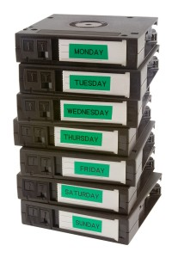
Importance of back up rotation
There are several preventive methods to help your company to avoid any disastrous situation.
Although cloud storage and backup services are becoming more cost effective, smaller businesses tend to stick with the type of backup system that’s been working well for decades- which in most cases is offsite tape storage and rotation.
Magnetic tape is an ideal storage medium for backing up individual workstations or small networks, mainly because it has the capability of storing high volumes of information at a low price.
An efficient data recovery plan involving off-site magnetic tape storage would not be complete without rotation. Companies must rotate their tape cartridges to ensure that their backup data remains up-to-date.
There are several different methods, strategies and rotations that are commonly used to ensure that all data is properly backed up and secure. Here are some insights on tape rotation strategies and how often you should rotate them

Slide 36
A good rotation strategy ensures that the company can access data without fail. It protects the tape from excessive wear and damage, which could make it impossible to retrieve data.
Tape rotation requires a regular schedule, often with added expenses that offer greater security against disaster.
Tape Rotation Frequency
The frequency of rotation depends on whether the company relies on data storage and retrieval.
Companies with high volumes of sensitive data may require a complex and secure rotation schedule while small businesses may only need to implement something simple and cost-effective.
Most companies use one of three rotation schedules, including the Grandfather-Father-Son, and Tower of Hanoi scheme.

Slide 37
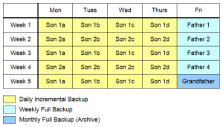
Grandfather-Father-Son (GFS)

Slide 38
The Grandfather-Father-Son (GFS) is the most widely used scheme for tape backup rotation. It combines security with ease of implementation.
Its simplicity comes from running on a traditional calendar.
On the last day of every month a full backup is performed and labelled ‘grandfather’. This tape is stored permanently offsite.
On the last day of every week a full backup is done called the ‘father’ and stored offsite.
Then daily an incremental backup is done called the ‘son’.
Son tapes can be stored onsite or offsite depending on the volume of data changes.
Adding up the tapes you will have: 4 son tapes (assuming a five day work week), 3 father tapes and a new grandfather tape every month.
Operates on the same principle; however, it involves using more tapes to backup information daily, weekly, and monthly.
Companies use the son tapes for daily backup, father tapes for weekly storage, and grandfather tapes for monthly archival.Many companies opt for permanent storage on a quarterly or yearly basis with the grandfather tapes.
Major difference between the volume and grandfather backup is that the grandfather incorporates a one-month archive in the backup scheme. This eliminates the problem of overwriting a tape before completing a more recent backup of the file system

Slide 39
Tower of Hanoi
The Tower of Hanoi rotation method involves full backup rotation using five separate tape sets. Many companies avoid this method due to its complexity.
This method offers greater security and flexibility for full backup sessions on a nightly, weekly, and monthly basis.
It’s the most secure tape rotation scheme-but also the most complex one. Here’s how it works:
The A tapes are used for a full backup every other day
The B tapes are used for a full backup every 4th day
The C tapes are used for a full backup every 8th day
The D and E tapes are alternated for a full backup every 16th day
Or said another way:
Tape A is used every odd numbered day.
Tape B is used every other even numbered day.
Tape C is used every third numbered day.
Tape D and E are used every fourth even numbered day.
The B, C, D and E tapes are stored offsite.
Confused? That’s because this rotation method doesn’t operate on a traditional work week calendar. If you implement this scheme it is wise to have automated reminders to help everyone keep track of what tape is to be used each day.

Slide 40
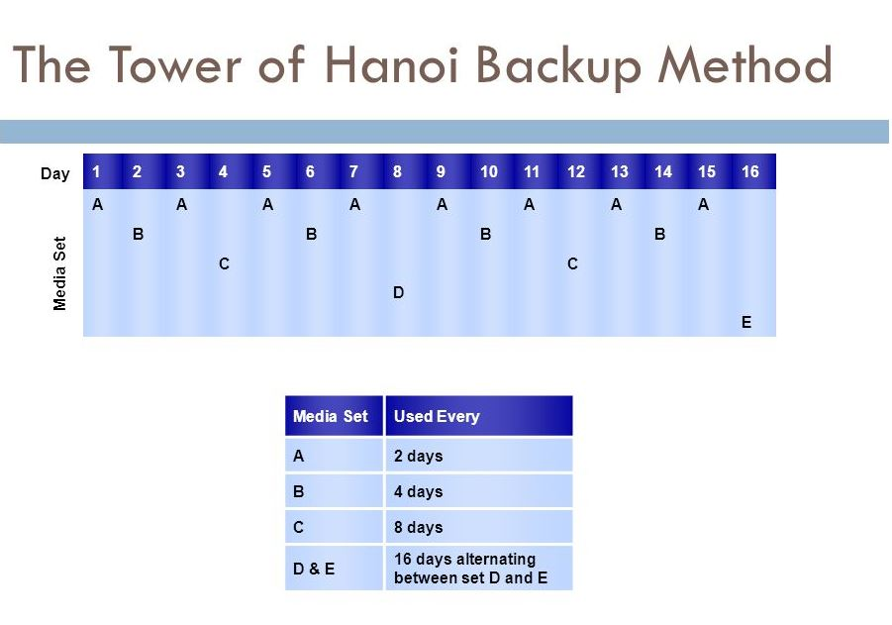

Slide 41

Volume/calendar backup
This backup strategy calls for a full system backup once a month.
An incremental backup is performed once a week for files that change often.
Daily incremental backups catch files that have changed since the last daily backup.
A typical schedule would be to perform the full backup one Sunday a month and weekly incremental backup on every Sunday.
Daily from Monday to Saturday – 5 incremental backups
This would require eight complete set of media ( one monthly tape, one weekly tape and six daily tapes)

Slide 42
Recovering from the complete data loss with the volume / calendar scheme requires restoring from the most recent full backup, then restoring from the most recent weekly backup, and finally restoring from each daily backup tape written since the weekly backup.
An advantage to this backup scheme is that it requires a minimum of media, but this also points out one of the major problems with this backup scheme : tapes are immediately reused.
For example, every Monday overwrites last Monday’s backup information.
Consider what would happen if one of the disk drives failed during the second Monday backup.
It would not be possible to recover all data, because the system was in the process of overwriting the backup tape when the drive failed.
No Matter What Rotation Method You Choose- Use It
The most important thing for any tape rotation system is to get started.
A poorly designed one is far better than being left with no backup at all. Keep at least one tape stored in a secure offsite location.
Make sure the backup tapes are accessible at all times. It is also wise to test your backups at least quarterly.
What is critical data and where it is located can change and leave you missing valuable information when you need it most.
Do a full reload on a test system to see if you can withstand a disaster to your systems.

Slide 43
How to Fix Disk Boot Failure
Level of difficulty: Difficult Disk Boot Failure is a problem which arises when you try to boot the computer from the files installed on a disk which could be hard disk"
Materials Needed:
- A large number of disks to boot the system - piece of cloth - screw driver to open the cabinet - wires.
Step 1
floppy or CD-ROM. Disk Boot Failure could arise from a large number of sources. Few of the reasons are corrupt bootable disk
Step 2
order of devices to boot from in BIOS setting

Slide 44
Step 3
problem with IDE port of motherboard and many more. The problem could be solved in more than one way.
It really depends on which way works for you at this point of time.",Step 1 is to check your disk for any problem.
Check if the disk is properly inserted and is working fine i.e. it is not corrupt and all the data could be read by the disk reader easily.
Physically check all cabling connections in the computer system. A loose or in some cases
Step 4
failing cable will produce these errors.
Check if disk is not having any scratches and dust on it. If dust is there remove it and reinsert the disk and restart the system.
If problem still persists move to step 2.“
Step 5
Check for your BIOS setting. Check for the order of devices to boot from.
Because it might be possible that your settings allow your computer to boot only from the local hard disk and if that disk is not working properly your computer throws the error message as it is not having anything to boot from.
For this go to the BIOS settings by pressing 'Del' key during booting your computer. Then go to Bios settings and select the order of the disks in which you want to boot from.
Then save the changes and exit the system and restart. If the problem is still unresolved move to step 3.

Slide 45
Step 6
A weak SMP could also be a reason.
Check your battery for power supply.
If it was the reason for the problem change the SMP as the problem would arise again if you continue with the same SMP.
Step 7
Check your BIOS battery. It is the circular battery placed on the motherboard.
Check if it is working fine. A dead Bios Battery will also cause the same problem. So remove it, clean it with a piece of cloth and reinsert it.
Restart the system. If problem still exists move to next step.
Step 8
Remove your RAM from the motherboard and clean it with a piece of cloth and reinsert it properly onto the motherboard. Restart the system.
And if this also does not solve your problem call customer care persons of your computer's vendors as it might be a technical problem requiring professionals to handle it.

Slide 46
How to Set up and Use Automated System Recovery(ASR) in Windows XP
Windows XP's Automated System Recovery (ASR) is an extension to the conventional backup-and-restore.
It provides a framework for saving and recovering the Windows XP operating state, in the event of a catastrophic system or hardware failure.
Windows XP ASR recovers the target system in a two-step process. The first step, termed the boot recovery process, requires a new copy of Windows XP to be temporarily installed on the target system using the original distribution media.
The second step, called the OS restore process, restores the files of a previously saved Windows XP installation using a backup-and-restore application (this will delete/overwrite some of the files installed by the boot recovery process).
Note: Users of Windows XP Home are out of luck: ASR is not available on their system. While mentions of this feature do exist in the backup utility of Windows XP Home, ASR is only functional in Windows XP Professional. Please click here for some other options.

Slide 47
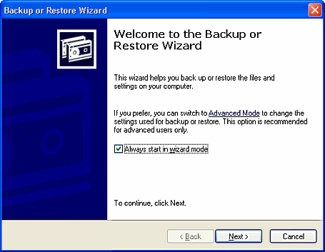
ASR Backup
The backup portion of ASR is accomplished through the ASR Wizard located in Backup. The wizard backs up the system state, system services, and all disks associated with the operating system components. It also creates a file containing information about the backup, the disk configurations (including basic and dynamic volumes) and how to accomplish a restore.
To start the process, click Backup under All Programs > Accessories > System Tools.

Slide 48
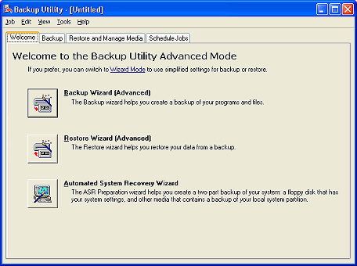
By default, backup will start in Wizard mode. In this case it's easier to start in the Advanced Mode. To do so, just click the link Advanced Mode.

Slide 49
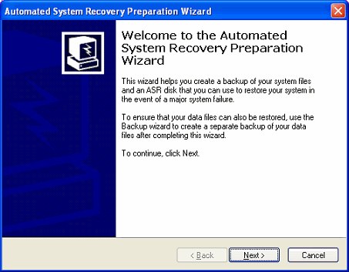
On the Welcome tab, click Automated System Recovery Wizard. This will start the Automated System Recovery Preparation Wizard.

Slide 50
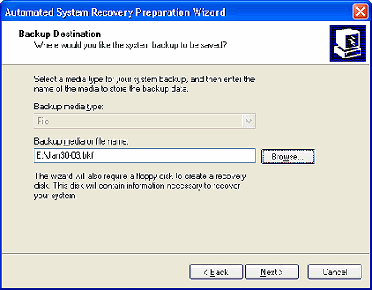
The wizard will prompt you for a location and name for the media to store the backup file.
By default drive A:\ will be selected, but for obvious reasons this isn't a good choice. You want to change the location to another disk-location.
The backup will typically be around 1.5-2.0GB (but could be more, depending on the amount of software installed), and since Microsoft's backup won't "span" a backup across multiple CDs, you'd have to find another media to store this backup on.
You could use anything from ZIP or Jazz drives, to a second hard disk drive, either internal or external.
Please note: you can't save the backup to the system drive (usually drive C:\), since this drive will be formatted when you do an ASR restore.

Slide 51
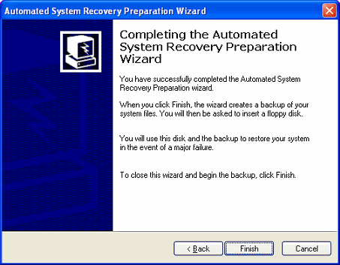
When you have selected the location and name for the backup, press Finish to end the Automated System Recovery Preparation Wizard.
When you do this, backup will create a list of all the files to backup, and then continue with the backup process

Slide 52
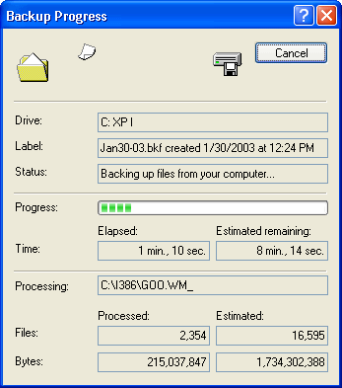
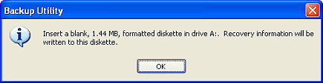
ASR only makes a backup of your files on your System drive (usually drive C:\).
If you use other hard drives, you will need to make a separate backup of your documents & files to make a complete "recovery" after disaster!
Once the disk-backup is done, ASR will prompt you for a blank, 1.44MB, formatted floppy disk to store some recovery data.

Slide 53
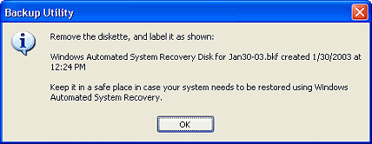
When ready, label the diskette. Pressing OK ends the backup portion of ASR
You will need to keep your ASR backup up-to-date.
If you make any changes to your OS, you'll need to make a new ASR backup.
When installing updates from Microsoft, most will prompt you to make a new ASR backup after installing the update.

Slide 54
ASR Restore
ASR will read the disk configurations from the file that it saved on the ASR diskette and restore all of the disk signatures, volumes and partitions on, at a minimum, the disks required to start the computer (It will attempt to restore all of the disk configurations, but under some circumstances, it might not be able to).
To use Automated System Recovery to recover after a system failure, you need to have the following items before you begin the procedure:
Your Automated System Recovery floppy disk
Your previously created backup
Your original operating system CD
You should only use the ASR backup to restore your system if all other methods to start your Windows XP system have failed.
Your system drive (usually drive C:\) will be formatted and you will lose any information that was not backed up recently!
To start the restore process, insert the original Windows XP CD in your system's CD-ROM drive, and reboot your computer (make sure that the option is set in your computer's BIOS to boot from CD-ROM. Check your computer's or motherboard's manual on how to do this).
Usually you'll get a message to Press any key to boot from CD...

Slide 55
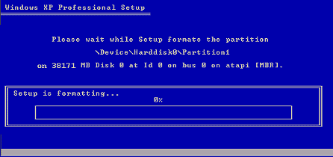
Once Windows Setup starts, you'll be prompted with the following text at the bottom of the screen: Press F2 to run Automated System Recovery (ASR)... so be prepared to hit F2 as soon as you see this.
Next you will be prompted to insert the Windows Automated System Recovery Disk into the floppy drive. Insert the disk, and press any key.
The ASR process will be started, and without any further prompts, your system drive will be formatted, after which setup will start copying its files to the hard disk.

Slide 56
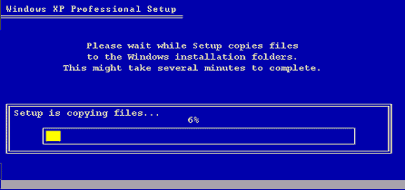
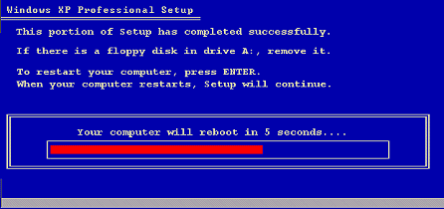
When ready, the system will prompt you to remove any floppy from the floppy drive, and will reboot the system automatically (this time do not press any key to boot from the CD-ROM!).

Slide 57
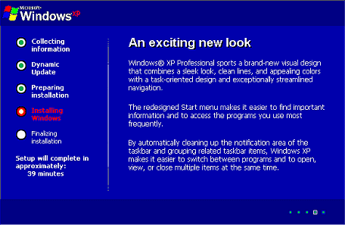
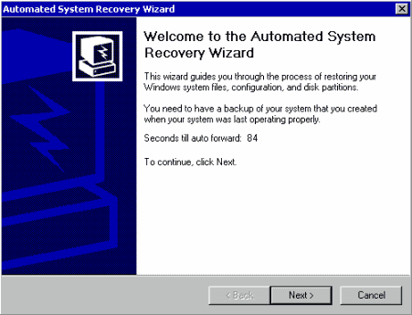
Windows setup will now continue much like a normal Windows setup would, but it will not do a complete installation.
After a few minutes, the Automated System Recovery Wizard will start. After 90 seconds it will automatically continue, if you want to speed this up, just press the Next button.

Slide 58
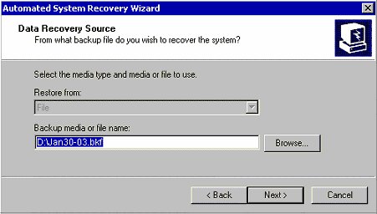
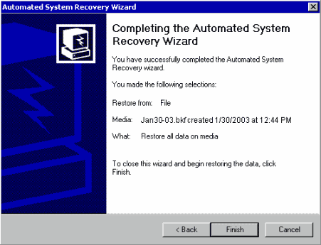
Next the ASR wizard will ask you for the location of your backup file.
By default it will list the location you saved the backup to previously, but if you since moved it to a different drive, you can use the Browse button to point to the new location.
This will close the ASR wizard, after which backup is used to restore the previous backup of your system drive.
After the restore phase is completed, your system will be rebooted, and you'll have it back in the same state as of the time when you created the ASR backup.

Slide 59
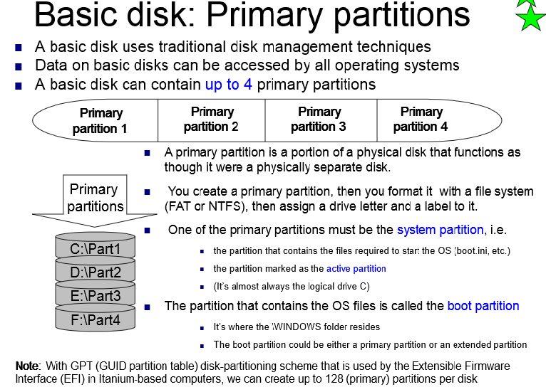

Slide 60
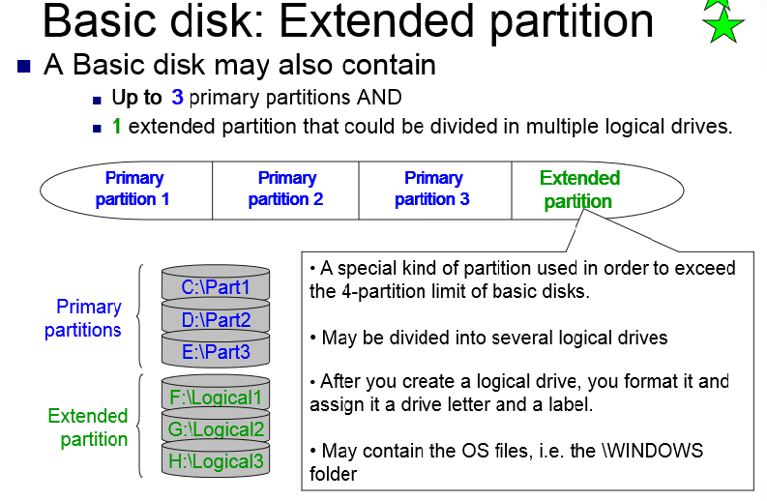

Slide 61
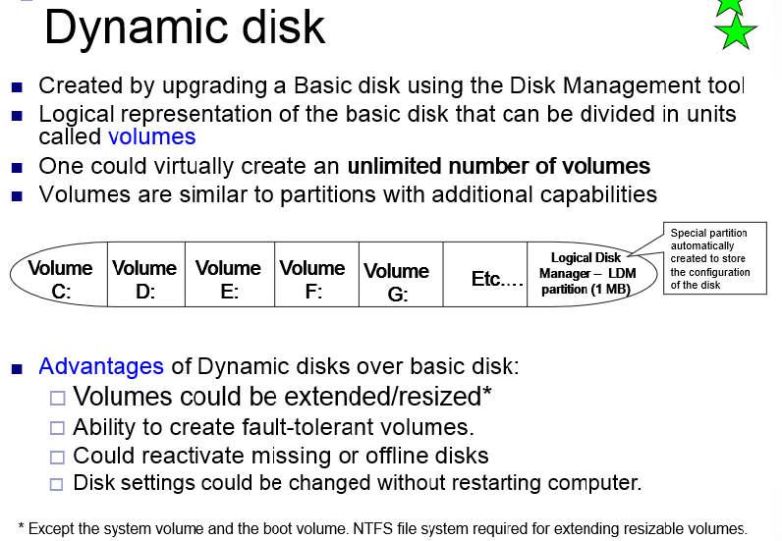

Slide 62
Dynamic Disk
Basic disks are the storage types most often used with Windows. The term basic disk refers to a disk that contains partitions, such as primary partitions and logical drives, and these in turn are usually formatted with a file system to become a volume for file storage.
Dynamic disks provide features that basic disks do not, such as the ability to create volumes that span multiple disks (spanned and striped volumes) and the ability to create fault-tolerant volumes (mirrored and RAID-5 volumes). Like basic disks, dynamic disks can use the MBR or GPT partition styles on systems that support both

Slide 63
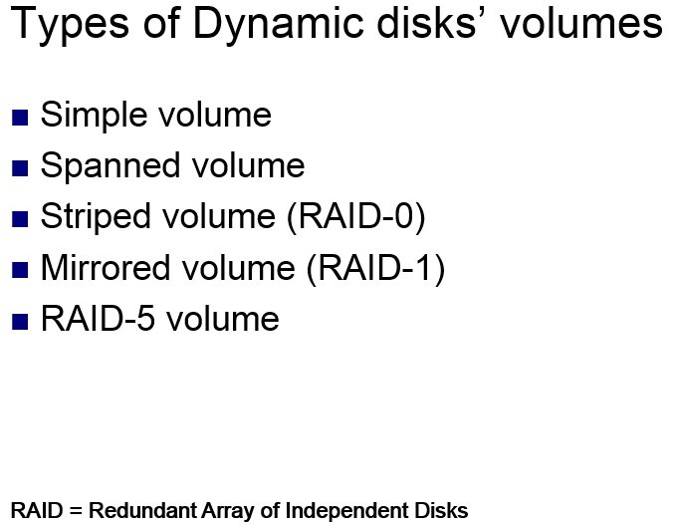

Slide 64
RAID
RAID stands for Redundant Array of Inexpensive Disks. It is used to enhance the performance, data availability, and capacity of the storage devices
RAID technology is used either as Software RAID or Hardware RAID
In Hardware RAID, drives are connected to the motherboard through special hardware called RAID controller whereas in software RAID the drives are connected directly to the motherboard whose configuration is managed by the utility software in the host computer’s operating system. The type of RAID that best suits your application depends on where you want to configure the drives.
Hardware RAID is an attractive option for applications that require complex RAID configuration whereas Software RAID is more affordable and is mostly suited for the workstation with limited data storage requirements. Software RAID best suits the entry-level servers which don’t require boot protection.

Slide 65
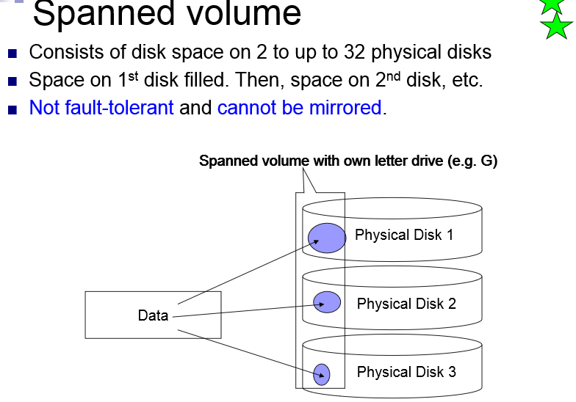

Slide 66
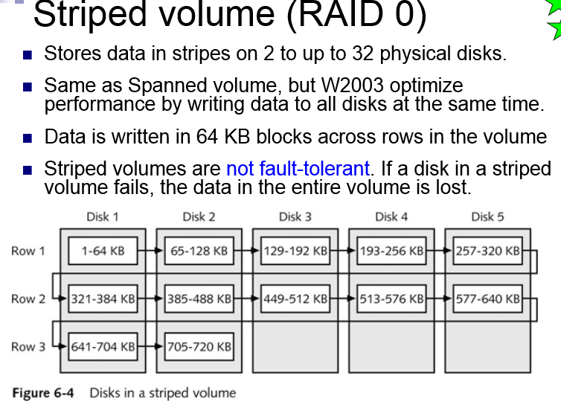

Slide 67
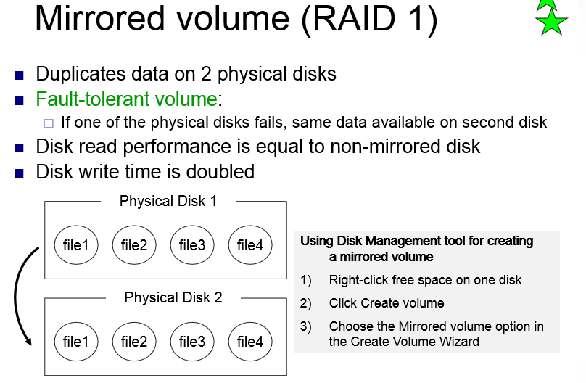

Slide 68
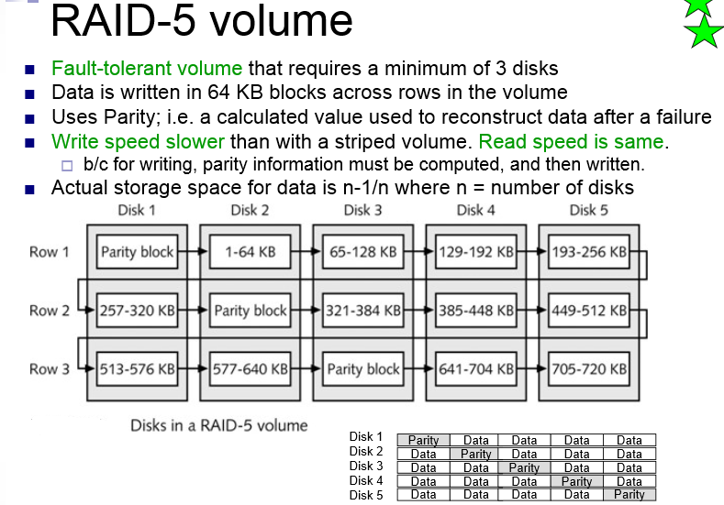

Slide 69
RAID software for Windows
Storage Spaces
SnapRAID

Slide 70
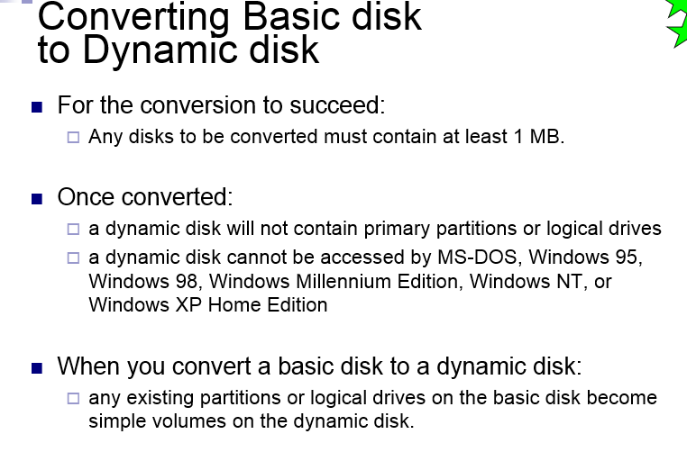

Slide 71
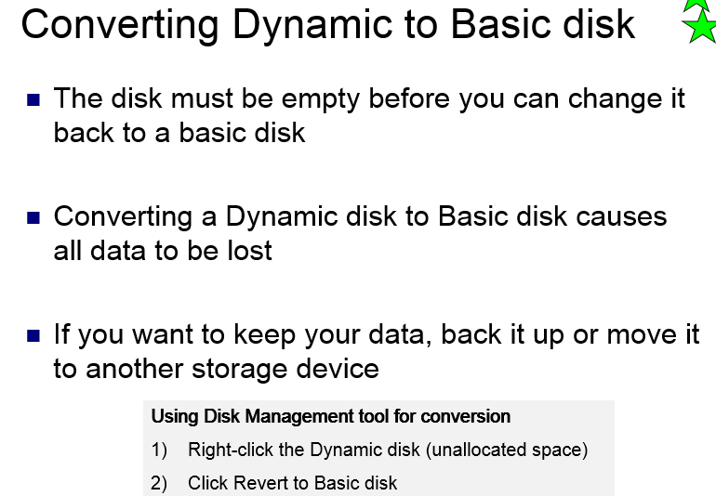

Slide 72
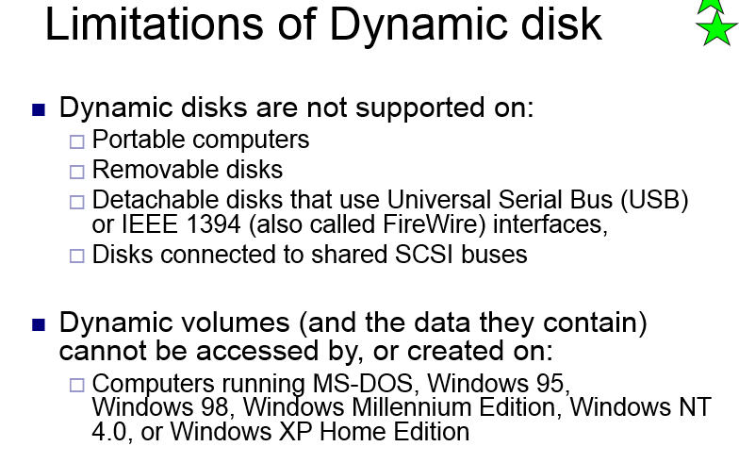

Slide 73
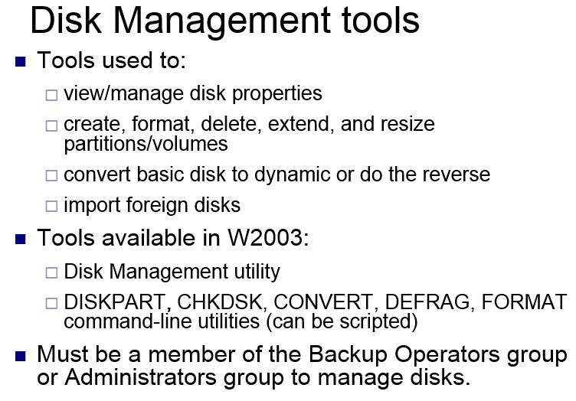

Slide 74
Disk Management
Disk Management is a snap-in that's part of the Microsoft Management Console supplied with Windows XP.
Just as the name Disk Management implies it's a tool used to manage system disks, both local and remote.
If you've been around personal computers for a number of years you're familiar with Fdisk, the utility that was used in conjunction with the Format command to set up hard disks from the command prompt.
Disk Management, with its graphical user interface, goes a long way to eliminating the need for the command prompt utilities and makes it easy to obtain a quick overview of the system and the relationships between installed disks.
Accessing Disk Management
There are a few different ways to access Disk Management. Here, following list three different methods so choose whichever is more convenient.
Method 1 - Start > Control Panel > Performance and Maintenance > Administrative Tools. Double click Computer Management and then click Disk Management in the left hand column.
Method 2 - By default, Administrative Tools is not shown on the Start Menu but if you have modified the Start Menu (by right clicking the Start button and selecting Properties > Customize) so it is shown then just select Start > Administrative Tools > Computer Management and then click Disk Management in the left hand column.
Method 3 - Click Start > Run and type diskmgmt.msc in the Open: line and click OK. The Disk Management snap-in will open.

Slide 75
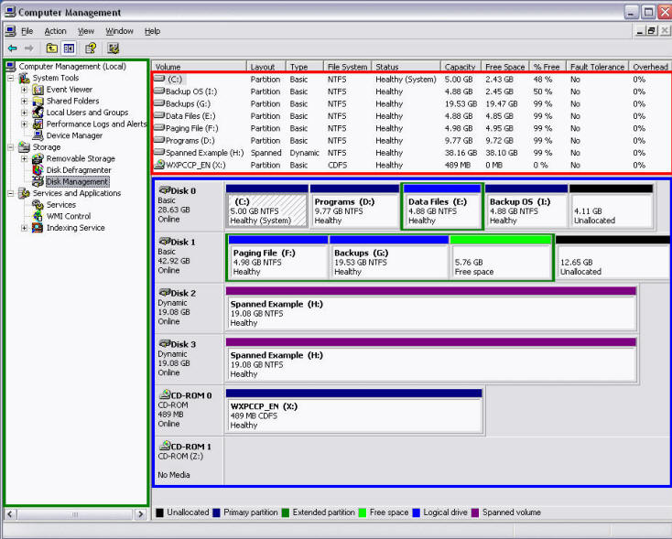
Three Basic Areas of Disk Management
The basic Disk Management console is divided into three main areas and just about as straightforward as one can get.
In Fig. the areas are defined by green, red, and blue rectangles.
The Console Tree is the tall vertical column on the left that's defined by the green color.

Slide 76
If Method 3 above is used to open Disk Management it will open without the Console Tree being displayed.
Suggestion to you to get rid of the Console Tree as it really serves no purpose once Disk Management is open.
Even if you used one of the other methods, the Console Tree can be eliminated by clicking the Show/Hide Console Tree icon (fourth from left) on the standard toolbar.
The red and blue areas are referred to as Top and Bottom and are both user definable via the View menu option.
By default, the Top area displays the Volume List and the Bottom area displays the Graphical View.
A third view called Disk List can be substituted in either pane if it's more to your liking, or the Bottom pane can be hidden completely.
The View menu option also contains a [Settings...] option that allows adjustment of the color schemes, size of the drive displays and a few other options so the console can be tailored to individual taste.

Slide 77
Basic Disk Management Functions
All too often the help documentation that's supplied with programs falls short of the mark, but in the case of Disk Management , Microsoft did an above average job.
suggestion is to give it a thorough read through as it contains detailed instructions for performing many tasks that it's not immediately apparent Disk Management can handle.
Here, list a few of the more common tasks that interest a wide cross section of users.
Create partitions, logical drives, and volumes.
Delete partitions, logical drives, and volumes.
Format partitions and volumes.
Mark partitions as active.
Assign or modify drive letters for hard disk volumes, removable disk drives, and CD-ROM drives.
Obtain a quick visual overview of the properties of all disks and volumes in the system.
Create mounted drives on systems using the NTFS file system.
Convert basic disks to dynamic disks.
Convert dynamic to basic disks, although this is a destructive operation.
On dynamic disks, create a number of specialty volumes including spanned, striped, mirrored, and RAID-5 volumes.

Slide 78
At first glance it may appear there isn't much substance to Disk Management, but in truth it can be quite useful for many tasks.
That's not to say it's without limitations because it does have some.
One of the major limitations is the inability to resize a partition to make it smaller in a non-destructive manner.
That limitation, and others, can be overcome by a number of third party utilities to fill in the gaps where Disk Management is lacking, but a full understanding of what Disk Management can and cannot do relative to your individual situation and needs will help you determine if a third party disk management utility is necessary.

Slide 79
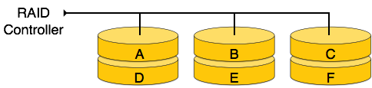
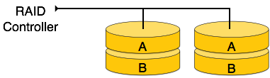
Redundant Array of Independent Disks
RAID or Redundant Array of Independent Disks, is a technology to connect multiple secondary storage devices and use them as a single storage media.
RAID consists of an array of disks in which multiple disks are connected together to achieve different goals. RAID levels define the use of disk arrays.
RAID 0
In this level, a striped array of disks is implemented. The data is broken down into blocks and the blocks are distributed among disks. Each disk receives a block of data to write/read in parallel. It enhances the speed and performance of the storage device. There is no parity and backup in Level 0.
RAID 1
RAID 1 uses mirroring techniques. When data is sent to a RAID controller, it sends a copy of data to all the disks in the array. RAID level 1 is also called mirroring and provides 100% redundancy in case of a failure.

Slide 80
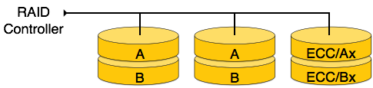
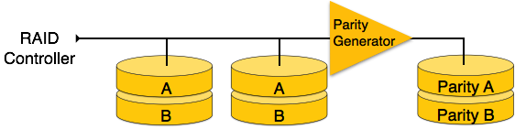
RAID 2
RAID 2 records Error Correction Code using Hamming distance for its data, striped on different disks.
Like level 0, each data bit in a word is recorded on a separate disk and ECC codes of the data words are stored on a different set disks. Due to its complex structure and high cost, RAID 2 is not commercially available.
RAID 3
RAID 3 stripes the data onto multiple disks. The parity bit generated for data word is stored on a different disk. This technique makes it to overcome single disk failures.

Slide 81
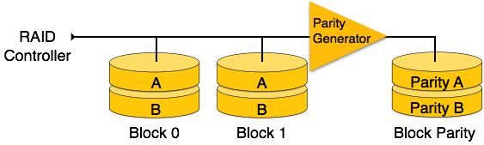
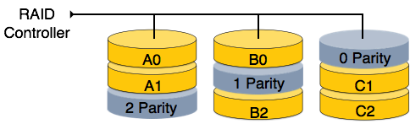
RAID 4
In this level, an entire block of data is written onto data disks and then the parity is generated and stored on a different disk.
Note that level 3 uses byte-level striping, whereas level 4 uses block-level striping. Both level 3 and level 4 require at least three disks to implement RAID.
RAID 5
RAID 5 writes whole data blocks onto different disks, but the parity bits generated for data block stripe are distributed among all the data disks rather than storing them on a different dedicated disk.

Slide 82
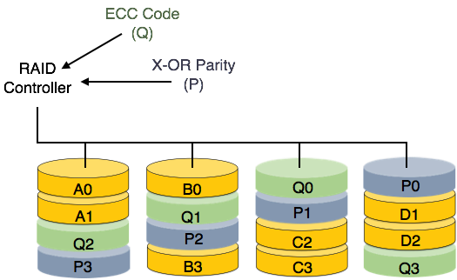
RAID 6
RAID 6 is an extension of level 5. In this level, two independent parities are generated and stored in distributed fashion among multiple disks.
Two parities provide additional fault tolerance. This level requires at least four disk drives to implement RAID.

